Slide 1
GenAI-powered Software Engineering
CSCI 7000-011
Tue/Thu @2pm
Danny Dig
Notes:
Over the Thanksgiving break I reflected on the many experiences we shared together this semester. Thank you for an energizing semester in CSCI 7000-011: GenAI-powered Software Engineering. It was a privilege to learn with you at the frontier of GenAI and SE.
I’m excited to connect with you in person for our last class today, and for those students who already traveled abroad to Asia, we missed seeing you in person, still nice to see you on Zoom.
For today I prepared several poll questions, so make sure you have a phone with a camera that you can point to the QR code or type in the code on Slido.

Slide 2
Today’s goals
Review what we covered in GenAI for Software Engineering: practice and research examples
Revisit your expectations from the class
What is NEXT?
Notes:
First I will attempt to review the 24 papers we read and discussed this semester. I know this took you dozens of hours to read them, so I will do my best to summarize them in a few slides.
We will revisit your expectations from the first day of the class and we will look at whether we met them.
Lastly, I will talk about what comes next, two new classes on GenAI that I am offering next semester.

Slide 3
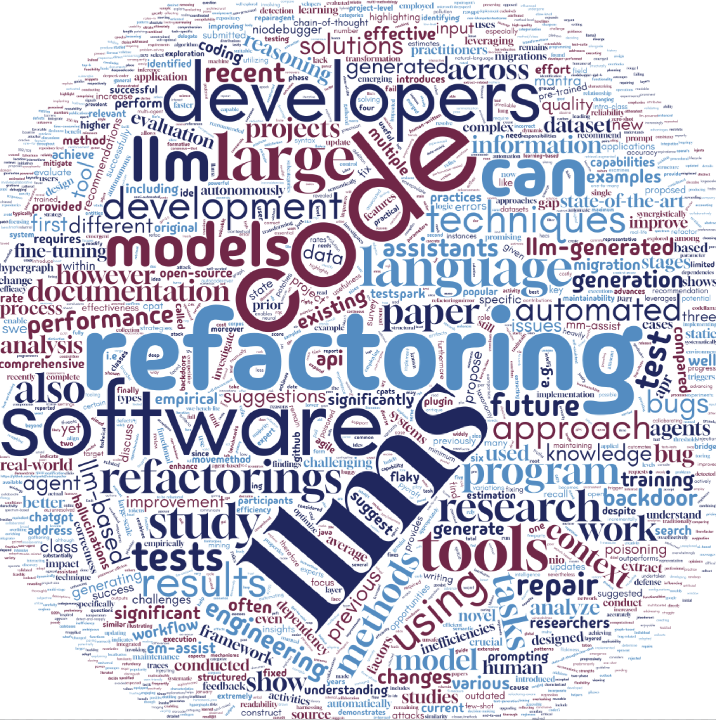
Overview of 24 research papers
Notes:
I took the abstracts of all 24 research papers we read this semester and fed them into a Word Cloud tool… basically the academic equivalent of putting everything in a blender.
This is the 10,000-foot view of what we covered.
Which obviously means class is over. Pack your bags.
…Okay fine, not exactly yet.”
You can see that we covered a lot of LLMs, software, tools, code.
Refactoring also features pretty highly since half of the class projects and therefore many papers we read were on refactoring.
Option 2 — More sarcastic humor
“I gathered the abstracts of all 24 papers we read, tossed them into a Word Cloud generator, and—voilà—the universe has spoken.
Here’s the 10,000-foot summary of our entire semester.
Which obviously means class is over. Pack your bags.
…Okay fine, not exactly yet.”

Slide 4
Revisit topics we covered
Foundations of GenAI for SE:
- major surveys of LLMs-for-SE and SE-specific LLM capabilities
- knowledge injection
- prompting effectiveness, impact of fine-tuning
Deep dives:
- LLM-based refactoring (ExtractMethod, MoveMethod, ExtractClass),
- code migration at Google
- test generation (TestSpark)
- automatic program repair (AutoCodeRover, RepairAgent)
- debugging (NIODebugger)
- documentation updates
- code generation / inefficiency taxonomies, AI Coding assistants
- agents (CoRenameAgent, RepairAgent, Mantra, effort estimation), human-AI collaboration
Revisit your expectations from the class
What is NEXT?
Notes:
Here is the 1,000 foot view.
We covered two kinds of papers:
(1) first: foundation papers about the usage of GenAI in SE: surveys and systematic literature reviews that covered the SE-specific LLM capabilities. We looked at the effectiveness of various prompts, fine-tuning, chain-of-thought, RAG
(2) Deep dives into state-of-the-art agentic and LLM-powered SE research — covering LLM-based refactoring (Extract Method, Move Method, MANTRA), code migration at Google, test generation (TestSpark), bug repair (RepairAgent, AutoCodeRover, NIODebugger), documentation updates,, code smell detection (iSMELL), agents, human-AI collaboration
ASK People to share what are some main takeaways they remember from reading such papers

Slide 5



Do not edit How to change the design
What was your main takeaway from the research papers we covered?
The Slido app must be installed on every computer you’re presenting from

Slide 6
1. LLMs as Core SE Infrastructure
Survey & SLR papers position LLMs as foundational for many SE tasks downstream
KEY Idea: LLMs are not one-off tools; they’re treated as core infrastructure that underpins many downstream tasks (generation, repair, refactoring, documentation, estimation, etc.)
Hybrid techniques (LLMs + traditional SE) are essential for reliable, efficient workflows.
Emergent properties enable creativity but raise challenges around control and correctness.
Notes:
Let’s look a little bit closer to the major themes we covered in class.
Many papers are about how to use LLMs in SE: surveys (LLM4SE), taxonomies of quality issues, prompting strategies, fine-tuning methods, and backdoor vulnerabilities.
LLMs are not one-off tools; they’re treated as core infrastructure that underpins many downstream tasks (generation, repair, refactoring, documentation, estimation, etc.).
Hybrid approaches (LLMs + traditional SE tools and techniques) are key to unleash the new productivity improvements.

Slide 7
2. Code Transformation & Refactoring at Scale
Focus on Extract/Move Method, Extract Class, migrations, and code-change patterns (CPATs).
Tools: PyCraft, EM-Assist, MM-ASSIST, MANTRA, HECS, and RefactoringMiner.
LLMs provide "expert" suggestions; static/dynamic analysis and IDEs enforce safety and mechanics.
Goal: align automated refactorings with developer intent while scaling to large codebases.
KEY Idea: synergy between LLM “intuition” and traditional static/dynamic analysis to make refactoring trustworthy
Notes:
Several papers (EM-Assist, MM-ASSIST, MANTRA, HECS, RefactoringMirror, refactoring detection, migration work at Google, CPAT/PyCraft) focus on:
Identifying refactoring opportunities (where to refactor).
Automating complex refactorings (Extract Method, Move Method, Extract Class).
Ensuring safety (no behavior change, compiles, tests pass).
Using LLMs plus static analysis / IDEs / hypergraph models to align refactorings with developer intent.
Big theme: synergy between LLM “intuition” and traditional static/dynamic analysis to make refactoring trustworthy.

Slide 8
3. APR, Debugging & Flaky Tests
AutoCodeRover, RepairAgent, layered-context APR, and NIODebugger target real-world bugs.
LLM-based agents plan, search, call tools, and validate fixes using tests and spectra.
KEY Idea: Layered knowledge (bug, repository, project) significantly boosts fix rates.
Special focus on NIO flaky tests and state pollution, combining dynamic analysis with LLM reasoning.
Notes:
Papers: RepairAgent, AutoCodeRover, layered knowledge injection for APR, NIODebugger, APR fine-tuning study.
Concerns:
Going beyond single-prompt APR to agentic workflows that search, gather info, and iteratively validate patches.
The importance of context layers (bug, repository, project) for repair success.
Special focus on NIO flaky tests and state pollution, using an LLM agent plus dynamic analysis.

Slide 9
4. Testing and Quality of LLM-Generated Code
TestSpark integrates search-based and LLM-based test generation directly in the IDE.
Taxonomy of inefficiencies highlights logic, performance, readability, and maintainability issues.
Prompting strategies (Few-Shot, CoT, CoT+Few-Shot) clearly outperform Zero-Shot at class level.
KEY Idea: Emphasis on both functional correctness and long-term code quality metrics (e.g., BLEU, ROUGE).
Notes:
Papers on:
TestSpark (LLM+search-based test generation in the IDE).
Taxonomy of inefficiencies in LLM-generated code.
Prompting strategies (Zero-Shot vs Few-Shot vs CoT) and their impact on correctness and BLEU/ROUGE.
NIODebugger & APR work also tie into testing and regression robustness.
Emphasis on measuring and improving the quality (not just correctness) of generated code and tests.
ASK: tell students to add a description in their Final project report about which prompt strategies they used, what you found was more effective.

Slide 10
5. Agents, Collaboration & Human-in-the-Loop
SWE agents and in-IDE assistants support multi-step, interactive development workflows.
KEY Idea: Empirical studies show higher success when developers iterate and collaborate with agents.
Multi-agent frameworks coordinate roles (planner, critic, executor) and negotiate with humans.
Design goal: agents that challenge, explain, and co-create rather than act as sycophantic oracles.
Notes:
Papers: Software Engineering Agents (SWE agents), collaborative in-IDE agents study, AutoCodeRover, RepairAgent, MANTRA, CoRenameAgent, agile effort-estimation multi-agent framework.
Key motifs:
Moving from “LLM as black-box oracle” to LLM-powered agents that plan, call tools, and iterate.
Understanding how developers actually use AI assistants: where they help (tests, docs) and where trust/context gaps appear.
Multi-agent designs that negotiate, discuss, and reach consensus with humans.

Slide 11
6. Beyond Coding: Documentation & Estimation
LLMs update API documentation based on code changes, improving similarity to human edits.
Multi-agent LLM frameworks support agile effort estimation and consensus-building in teams.
Surveys reveal where developers already delegate work (tests, docs) to AI assistants.
Non-coding tasks become a major frontier for LLM support in the SE lifecycle.
KEY Idea: LLMs aren’t just for code generation—they’re being pushed into documentation, planning, estimation, and analytics.
Notes:
Papers on:
Updating API documentation with LLMs (code+text diffs).
Agile effort estimation with LLM-based multi-agent systems.
Large-scale surveys of AI-assistant usage.
These highlight our course’s framing: LLMs aren’t just for code generation—they’re being pushed into documentation, planning, estimation, and analytics.

Slide 12
7. Reliability, Safety & Security
Hallucinations in refactoring suggestions are filtered via static analysis and self-consistency checks.
- applying LLM-suggested changes using trusted engines to avoid unsafe edits.
Backdoor-attack study shows Code LLMs are vulnerable even at extremely low poisoning rates.
KEY Idea: Trust, policies, defensive techniques are critical for safe deployment of LLM-based tooling.
Notes:
Multiple abstracts emphasize:
Hallucination filtering in refactoring assistants.
Backdoor attacks on code LLMs and how training/inference parameters affect vulnerability.
Unsafe refactorings and the need for detect-and-reapply mechanisms (RefactoringMirror).
Broader concerns about trust, company policy, and safety in adopting AI assistants.

Slide 13

Do not edit How to change the design
Rank the topics you found most interesting/useful/valuable.
The Slido app must be installed on every computer you’re presenting from

Slide 14
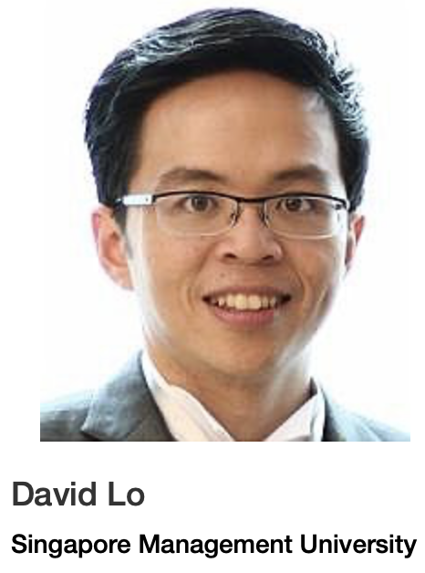

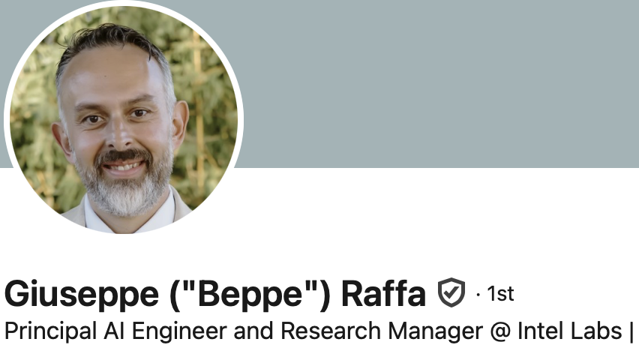



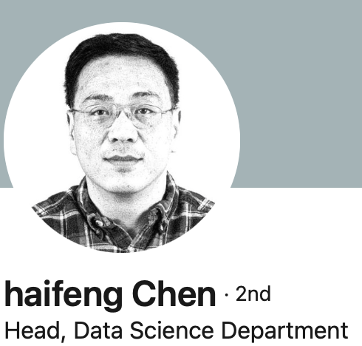

Invited Speakers: Thought leaders from Industry & Academia
Code, Critique, Cure: Advancing LLM Reasoning for AI-Augmented Software Maintenance
From Tools to Teammates: Generative AI as Collaborative Partners in Industrial Workflows
The Landscape of AI-assisted Automated Software Engineering
Advancing LLM Intelligence: Uniting Internal Reasoning and External Tool Interactions
Notes:
ASK people to share what is something that stood out to them from these industry talks

Slide 15
Your growth through research papers
You read 24 research papers
Paper Critiques: Equipped you with critical thinking
- learned to evaluate research claims, empirical methods, and limitations in modern GenAI+SE research
Research paper presentation: you prepared, delivered, and led class discussion
Equipped you to communicate and connect with the audience
Notes:
When I talked with you 1-on-1, several told me that reading research papers takes a lot of time, you never read so much research in any other class. It stretched you.
You developed critical thinking skills: analyzing dozens of top-tier papers from ICSE, FSE, ICSME, ISSTA, ASE, TSE, and ASE Journal; learning to evaluate empirical methods, research claims, and limitations in modern GenAI+SE research
While some of you are already very good speakers and presenters, this is an area where we all can improve. Billionaire Warren Buffet says that if you learn how to communicate and present, this is the most important skill you can learn, it would increase your networth over a lifetime by at least 50%.
I have seen tremendous improvements from your presentation #1 to presentation #2.

Slide 16
Your growth through hands-on projects
Hands-on project work — pitching ideas, forming teams, and progressing through four milestones to design, implement, evaluate, and present a novel GenAI/agentic-SE system or study.
Exercised the whole lifecycle of open-ended, risky project: pitching ideas, forming teams, design, implement, evaluate, and present a novel GenAI SE system
Four awesome research projects:
Project-Aware Local Variable Renaming with LLM
RepoGraph-NIO: Verifiable LLM-Driven Repair of Order-Dependent Tests
Prioritization for Agile Planning in SWE
GenEC: Extract Class with GenAI
Equipped you to lead novel R&D
Notes:
Hands-on project work
CLICK
You followed the steps of a typical research project (which are open-ended, risk-taking projects)
CLICK
If you do high-quality research & publish your research, you are guaranteed an A in the class!!
CLICK
At times, you might feel a bit lost in the beginning as you have to discover on your own, this will equip you with the skills you need to do well in graduate school.
— pitching ideas, forming teams, and progressing through four milestones to design, implement, evaluate, and present a novel GenAI/agentic-SE system
WHY: equipped you to lead. You did not come to grad school to learn how to code, you already knew that. You are getting your MS and PhD because you want to lead in this new era.

Slide 17

Do not edit How to change the design
How confident do you feel about using LLMs in your projects after this course?
The Slido app must be installed on every computer you’re presenting from

Slide 18

What are your expectations from CSCI 7000-011: GenAI for SE?
Do a cool GenAI Project that helps programmers/society
Learn about exciting GenAI Applications for SE
Exposure to research on GenAI for SE
Learn about the Challenges in building GenAI software
Learn how GenAI software differs from classical software
How to leverage the strengths of each tool
How academia changes to adapt to AI
Best practices and ethical use of these tools
How to make scalable GenAI systems
Notes:
At the beginning of the semester (on Day 1) I asked you what are your expectations from this class, This is what you told me.
Let’s visit them and see whether and how we met those expectations.

Slide 19
Do not edit How to change the design
What is one expectation you had from this course that you feel was met?
The Slido app must be installed on every computer you’re presenting from

Slide 20

You grew so MUCH
Research papers & critiques
Presentations
Hands-on project work
Notes:
I am proud of you all. You learned so MUCH. You can easily see this yourself if you compare how long it took you in the beginning of the class to read and write paper critiques, and how you got much better at this through the semester.
Look at how much your presentations have improved between your first and second presentation.
Take your left arm and put it over your right shoulder, then your right arm and put it over your left shoulder. Hold tight and give yourself a BIG hug. You should be proud of yourself as I am proud of you.

Slide 21
Do not edit How to change the design
How satisfied are you with your learning experience in this course?
The Slido app must be installed on every computer you’re presenting from

Slide 22

Summary and What’s Next
Change is the only guaranteed constant
“AI will not displace programmers. But programmers who use AI will displace programmers who do not use AI.” – Prof Danny Dig
Together We Continue to Go Further
CSCI 7000-005: Agentic Software Systems
- build an AI Agent that you can showcase in your portfolio
CSCI 7000-006: AI-Driven Leadership
- use AI to augment your ability to communicate, lead with values, and people skills
Notes:
The Greek philosopher Heraclitus told us 2500 years ago that change is the only guaranteed constant. Our society is going now through a seismic changes, similar in scale and impact with the industrial revolution and the information revolution transformed our society.
60% of the Jobs today did not exist in 1940. Similarly, I think AI will create new jobs and will change existing workflows for knowledge workers. The boat has already left the port, you don’t want to be left behind. That’s why you took this course and you worked hard and grew so much into these new skills.
So what comes next? You already saw how far we went together and how much we grew together this semester.
Together We Continue to Go Farther!
COME with me virtually to New York AI Summit next week! I can livestream some of the talks and keynotes from the convention center on Wed-Thu.
I encourage you to continue using AI in your workflow, and if the initial results you are getting are underwhelming, you are now equipped with many techniques that you can use to improve the results.
CSCI 7000-05 class (Mon/Wed 5:05-6:20pm)
DESCRIPTION: This course explores the emerging paradigm of building software systems from LLM-powered agentic components -—. We will read and discuss cutting-edge research on intelligent software agents and gain hands-on experience developing agentic systems using modern frameworks such as LangChain,
AutoGen, and MCP. The course combines seminar-style discussions with a team-based project.
I hope that you would build a LLM-powered Agent that you can include in your portfolio and resume. This would give you an edge over competition when applying for jobs, internships, etc. I've already heard from students in our class that they were invited for several meetings at the recent CareerFair based on their experience they got from our current GenAI-powered SE course. Having a deep knowledge of Agents and the experience of building one over the length of a semester should make you stand out even more for current/future employers.
CSCI 7000-06 class (Wed 6:40-7:30pm)
DESCRIPTION: This seminar explores how computer scientists and engineers can harness generative AI as a thinking partner to enhance strategic reasoning, problem-solving, and communication. Through readings, discussion, and reflection, students examine frameworks for human–AI collaboration and the evolving role of AI in leadership. The course emphasizes applying AI tools and leadership principles to develop values-driven, adaptive leaders for an AI-augmented future.
In one of our previous meetings, we discussed the new workforce and work dynamics, and what remains uniquely human in the new GenAI era. As GenAI raises the bar for technical competency, employers appreciate even more skills that are uniquely human: your ability to communicate, lead with values, and mastery of "people skills". This is where you can use GenAI as a thinking strategic partner to hone such skills. The AI-driven Leadership will give you a chance to start that process now. Leadership skills are not developed in a microwave instantly, this is more similar to a slow-cooking process. The sooner you start, the further you go. You will get a chance to choose leadership values that are close to your heart and develop those throughout the semester (and beyond).

